Slide 1
Car Door Alarm
Presentation by
Daniel Cerdeira and Nichelle Outlaw

Slide 2
Project Objectives
The goal of this application is to learn how to use the digital input and output (I/O) pins of the MSP430G2553 microcontroller.
All doors must close for the warning light to turn off.
As long as the car is locked, doors cannot be opened.

Slide 3
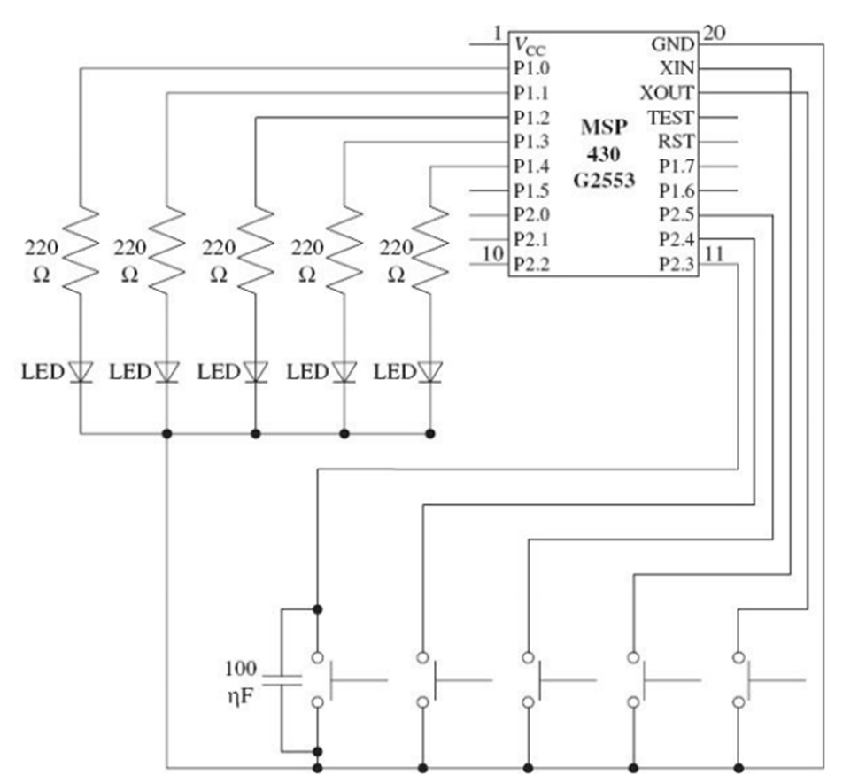
Schematic From the Textbook

Slide 4
Background Information
Input pins: P2.0-4
Output pins: P1.0-4
Red LED: Car doors 1-4
Green LED: Car alarm warning light

Slide 5
Pseudocode
If doors 1-4 are not closed,
then warning light is on.
Else if all doors are closed and master lock is on, then warning lock is off.

Slide 6
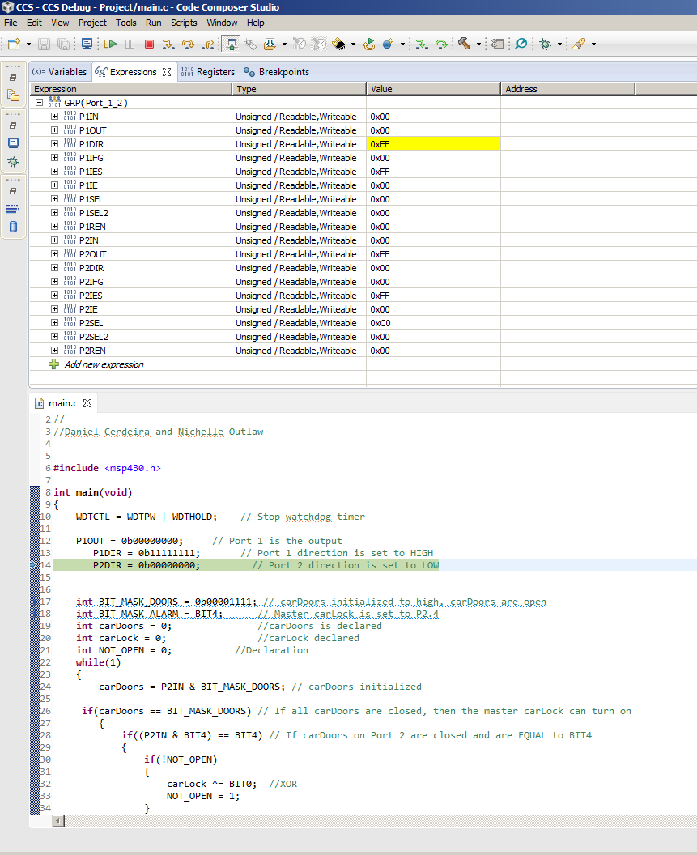
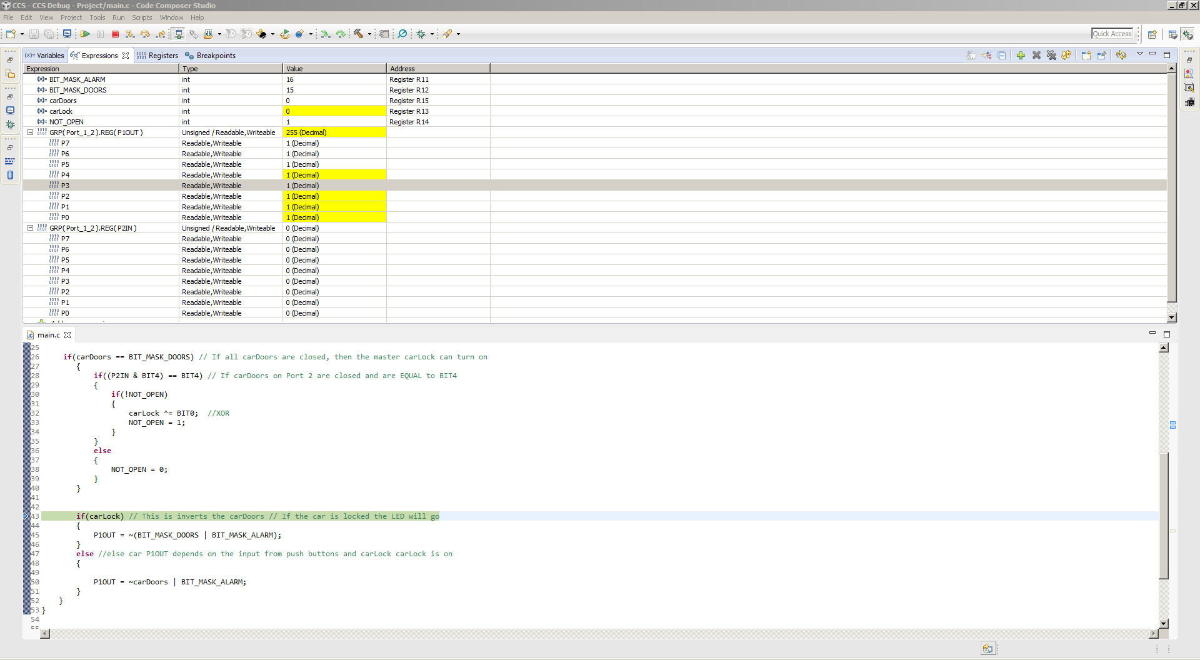
Before and Doors Open

Slide 7
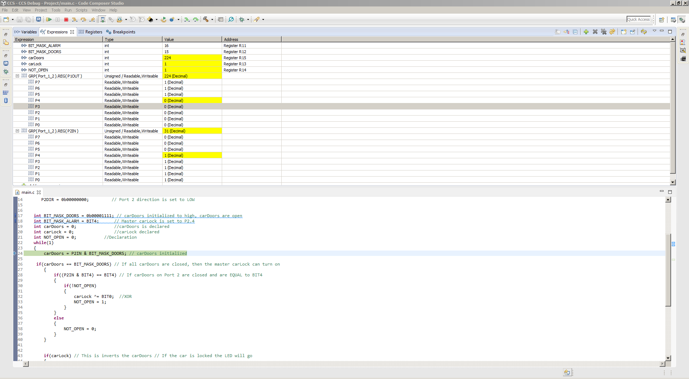
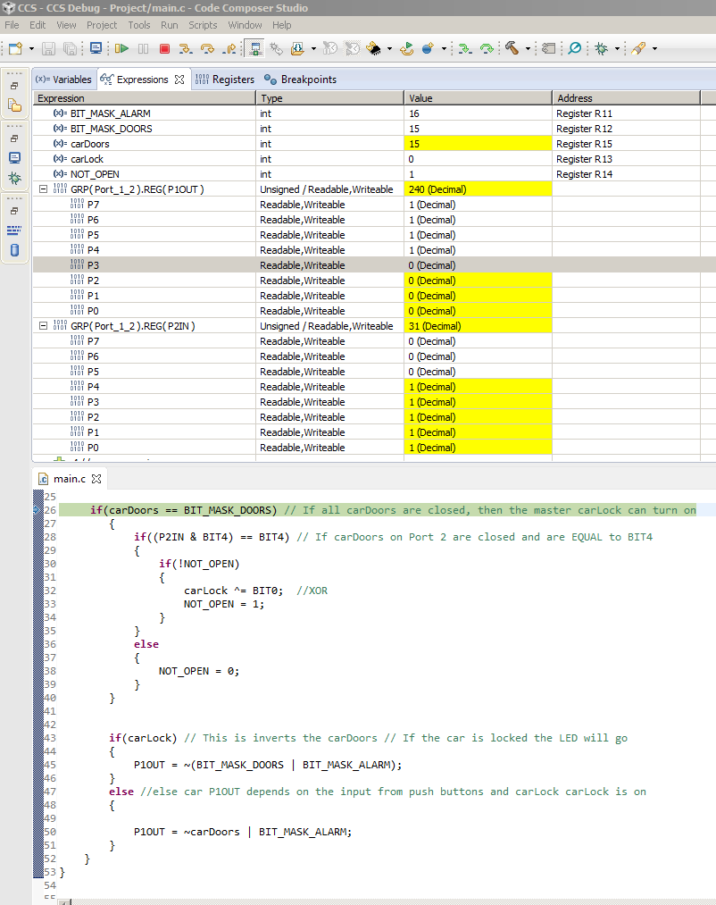
Doors Closed and Alarm Off

